Slide 1

CRITICAL INCIDENT REPORTING
Provider Training
September 2025
https://www.chfs.ky.gov/agencies/dms/dca/Documents/irinstructionalguide.pdf
Notes:
This Power Point presentation will guide you on Critical Incident reporting. The link provided at the bottom of the slide will take you to the Incident Reporting Instructional Guide for 1915(c) HCBS Waiver Services.

Slide 2
Benefits of Critical Incident Reporting
Promotes consistency
Participant’s record reflects real-time events
Timely communication between providers
Identifies risks to health, safety and welfare
Opportunities to mitigate preventable incidents
Identifies trends
Documents provider actions
Increased oversight for Abuse, Neglect and Exploitation
Increased accountability for timely discharge and case closure
Notes:
There are many benefits of reporting incidents. Such as:
Promotes Consistency.
The participant's record is accurate and reflective of real-time events which is a benefit because it helps to tell the participant's story. This allows providers and DAIL to have a better understanding of what is going on with the participant.
Timely communication between providers
Helps to identify potential risk to health, safety and welfare which lead us into these next benefits.
It provides opportunities to be proactive and mitigate future risk.
Helps to identify trends. For example, the Risk Mitigation and Investigation Report (RMIR) ask if the participant has experienced three or more similar incidents in the last three months. If the participant has then the reporting provider should look at the risk mitigation efforts that have been attempted and if they need to consider other options.
They document actions taken by the provider to serve the participant.
In review of incidents, DAIL ensures appropriate reporting of abuse, neglect and exploitation.
DAIL also reviews for timely discharge and case closure. If case manager knows that a participant is not returning to services due to admission to LTC or if the participant passes away, program closure should begin upon notification.

Slide 3
Examples of Incident Types
BEHAVIOR
CONFIDENTIALITY BREACH
ELOPEMENT
ENVIRONMENTAL
ILLNESS OR INJURY
DEATH
MEDICATION
PUBLIC HEALTH CONCERN
SUSPECTED ABUSE
SUICIDE
SUSPECTED EXPLOITATION
SUSPECTED NEGLECT
Self-Neglect
Alleged Criminal Activity
Natural/Expected
Unexpected
Discussing participants information with outside parties.
Found
Still Missing
Loss of Utilities
Forced Eviction
Fall
Seizure
Adverse Reaction
Missing Medication
Diagnosis of Contagious Disease
Mental/Emotional
Physical/Sexual
Attempt
Ideations
Unpaid Bills
Missing Money
Mental/Emotional
Physical/Sexual
Pest Infestation
Scams
Wounds
Wandering
Restraints
Notes:
These are the twelve different types of incidents you will select from when submitting a CIR. In each category we have provided examples of types of incidents.
We want to draw your attention to the suspected abuse category, specifically Restraints. When looking at waiver assurances and performance measures, specifically appendix G, Health and Welfare, Participant Safeguards, Kentucky policy and procedures prohibit the use of restraints and seclusions, which is also a federal expectation. Kentucky must then ensure providers are following this guidance. Providers are not only responsible for ensuring there are policy and procedures in place that prevent the use of restraints but also reporting in the event these expectations are not followed.
As we move along in this presentation, we will clarify the definitions of physical and chemical restraints as well as seclusions. Staff should be trained and know the difference. This is critical in accurate incident reporting and meeting waiver assurances in this area.

Slide 4
Critical incidents are serious in nature and pose immediate risk to the health, safety, or welfare of a waiver participant or others.
Suspected Abuse, Neglect, and Exploitation
Homicidal and Suicidal Ideation
Event Involving Police/Emergency Personnel
Serious Medication Error
Natural/Unnatural or Expected/Unexpected Death
Unplanned Hospital Admission, Emergency Room or Urgent Care Visit
Other incidents or conditions not directly defined that are serious in nature and pose immediate risk to health, safety, or welfare of the waiver participant or others.
Notes:
Critical incidents are serious in nature and pose immediate risk to the health, safety or welfare of a waiver participant or others.
Here are a few examples of critical incidents- suspected abuse, neglect, or exploitation, homicidal and suicidal ideation, an event involving police or other emergency personnel, serious medication errors, a death no matter the categorization, any unplanned hospital admissions, emergency room or urgent care visits.
Please refer to the instructional guide for specific information regarding incidents and when to categorize the incident as non-critical verses critical.

Slide 5
ALL participant deaths are classified as CRITICAL in nature and require a Risk Mitigation and Investigation Report (RMIR)
Notes:
We have chosen to highlight the information contained on this slide as death incidents continue to be downgraded and classified as non-critical.
A participant’s death should always be seen as CRITICAL in nature and treated as such.
These incidents should never be downgraded.
While additional risk mitigation efforts cannot be provided to this participant, the agency should investigate and document the events surrounding the participant’s death.
Furthermore, the agency can review death incidents as part of their quality assurance process to evaluate service delivery and ensure all services and necessary supports were being provided. This is an opportunity to learn and grow as an agency.

Slide 6
Incidents Involving Police or Emergency Personnel are categorized as CRITICAL- Examples
Police welfare check requested
Emergency Medical Services (EMS) respond to the home
Notes:
Key take away: any event involving law enforcement or emergency personnel is critical in nature.
The attendant care provider is unable to get the participant to open the door. In return they request a welfare check be completed. The police go to the participant’s home to check on the participant. They are home and safe. This incident would still be critical in nature because law enforcement was deployed to the residence.
The participant falls at home and EMS is called; however, the participant refuses to go to the hospital. This incident would still be considered critical in nature because EMS was involved.

Slide 7
Non-Critical incidents are minor in nature and do not create a serious consequence or risk for waiver participants.
Minor Injury
Medication Error without Serious Outcome
Notes:
An example of a non-critical incident would be if the participant had a seizure but did not require medical intervention.
Please keep in mind if the incident is non-critical but the participant has three or more of the same incidents within the last 90 days the incident would need to be categorized as critical so that an RMIR can be completed.

Slide 8

Medication
Critical incident
If the participant refuses three or more doses of medication
If it involves an adverse reaction, missing medication or wrong dose/ wrong medication
Medication error is the result of suspected neglect, such as medication being intentionally withheld as punishment or results in the participant’s death.
Medication is alleged to have been stolen.
Non-Critical
If participants refuses two or less doses of medication
This Photo by Unknown Author is licensed under CC BY
Notes:
Incidents involving medication could be either critical or noncritical in nature.
It is important to consider the impact to the participant.
If it was the participant’s choice to refuse medication, or if medication is missed because of an intentional neglectful act.
If a participant’s medication is alleged to have been stolen, this would also be classified as a critical incident as this criminal activity would need to be reported to law enforcement.

Slide 9

Incidents That Do Not Require an Incident Report
Scheduled Medical Procedures/Surgeries
Requests to change a case manager
Requests for services to be placed on hold
Peer to Peer interactions with no observed impact on health, safety, or welfare
Lifestyle choices
Diagnosis of Flu or Sexually Transmitted Diseases with no suspected abuse
Notes:
An incident will need to be submitted if the participant has bed bugs and services have been put on hold.
This incident is considered environmental and is affecting the participants health, safety and welfare.

Slide 10
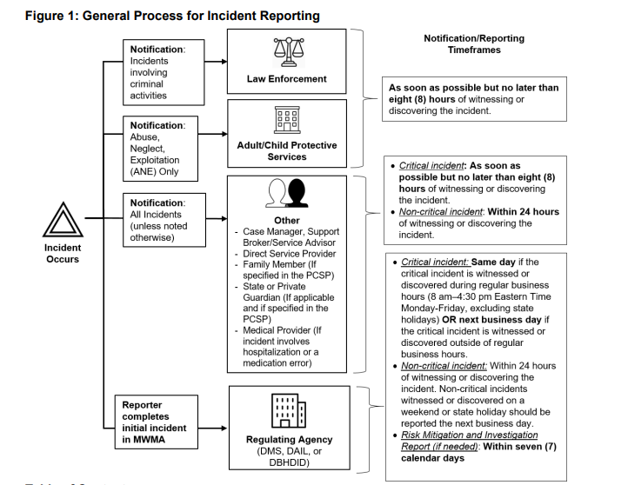
Notes:
Please be mindful that the timeframe for reporting is not based upon the provider’s business hours.
Regular business hours are 8am-4:30 pm, eastern standard time Mon-Friday excluding state holidays OR the next business day if witnessed or discovered on the weekend.
If the incident involves abuse, neglect or exploitation you should notify the appropriate authorities – Department for Community Based Services (DCBS) , you can do so by phone or web.
Please keep in mind that if you call in a report verses completing it online you have more opportunity to give information and voice your concerns. If the incident involves criminal activity, you should also notify law enforcement. An example where both DCBS - Adult Protective Services (APS) and law enforcement would need to be notified would be if the participant had money missing and it was suspected that the caregiver stole the participants money. Adult Protective Services would need to be notified for suspected exploitation and law enforcement for criminal activity.

Slide 11
Incident Reports and Requirements
If the incident occurs at the direct service provider location, the direct service provider is responsible for completing the report.
If the incident does not occur at the direct service provider location, then the first person who witnessed or discovered the incident is responsible for completing the report.
A designated staff member may complete and submit the incident report, but the waiver provider is ultimately responsible for the content.
Notes:
Here we are going to review the incident report and who is responsible for submitting the incident.
Per the instructional guide if the case manager discovers an incident occurred at a DSP location the case manager should follow-up with the DSP to ensure they complete an incident report.

Slide 12
Medicaid Waiver Management Application (MWMA) Timeframes
Date Created & Submitted
Resubmit Date
Risk Mitigation and Investigation Report (RMIR) Due Date
(7 days from the Incident Report)
Case Manager Sign-Off
(7 days from the Risk Mitigation and Investigation Report)
Notes:
Please be aware of these timeframes on the incident reports. The created and submitted date must be the same. If the incident is not submitted the same day it is created, then it is considered late.
Classification of Critical vs. Non-Critical determines the reporting timeframe
Date Created – ASAP 8-24 hours from discovery or notification – Same business day if before 4:30 p.m.
Date Submitted on – Should be the same date as created on, to be timely
Risk Mitigation and Investigation Report Due Date – MWMA calculates the due date, and it is noted on the screen. This is seven days from the incident report.
Case Manager sign-off – Is due seven days from the date the Risk Mitigation and Investigation Report is submitted.
Resubmitted Date – Indicates information has been added or provider has responded to a Request for Information (RFI).

Slide 13
Incident Documentation Screens
Incident Report
Risk Mitigation and Investigation Report (Case Manager)
Case Manager- Sign Off
Cabinet for Health and Family Services (CHFS) Fact Finding Report
Case Manager Fact Finding
Notes:
These are the five steps in the incident process.
Incident Report-this is where you complete the initial part of the incident. It is important to ensure all screens are completed, especially the notification page.
In the incident report you will have the option to select if a Risk Mitigation and Investigation Report is needed.
If the selection is made that the Risk Mitigation and Investigation Report is needed, then it will be due to be completed in seven days. The Department for Aging and Independent Living encourages agencies to use this time wisely and learn about the incident more in depth. It is important to identify risk mitigation efforts that would aid in the prevention of future incidents.
Case Manager-Sign off should be completed within seven days of the Risk Mitigation and Investigation Report.
The case manager should provide more information than simply stating “agreed.”
Case Managers should review the incident and do any follow up with the direct service provider or participant as needed. This is the content for the case manger-sign off.
The Case Manager-Fact Finding screens are to be used if the case manager disagrees with the findings of the Direct Service Provider’s Risk Mitigation and Investigation Report.
The Cabinet for Health and Family Services (CHFS) Fact Finding Report is completed by the Department for Aging and Independent Living (DAIL) staff. If DAIL has any questions or needs for information, they will submit a request for information (RFI).

Slide 14
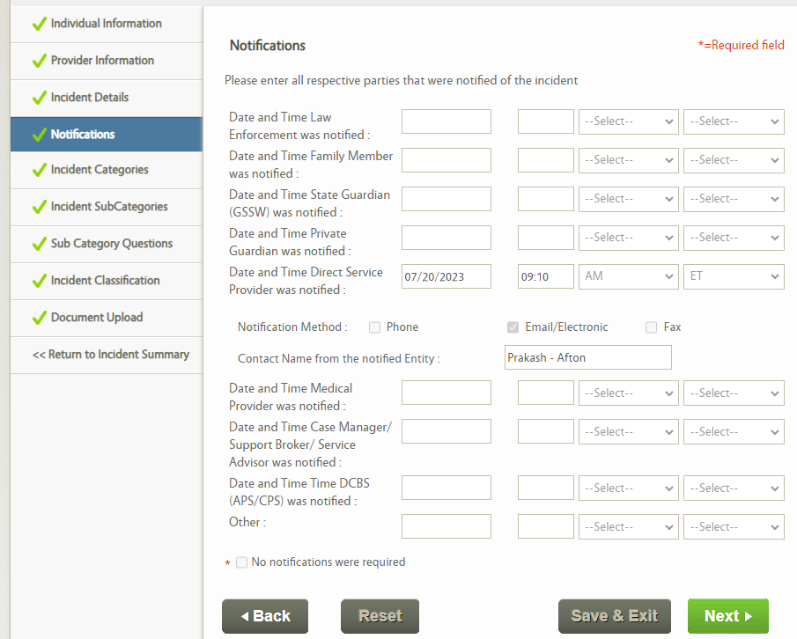
Notifications
Complete as much as possible
Case Manager and Department for Community Based Services (DCBS) notifications should be documented
Notes:
The notification timeframe is when the Direct Service Provider or Case Management Agency learn of the incident.
This is not the time that the incident occurred, unless the provider was present and witnessed the event.
Often, providers learn about an incident well after the fact. It is important to keep these timeframes straight as they impact the assessment of the agency's responsiveness to the incident report.

Slide 15
Notifications – Required Reporting
Criminal
Incidents alleging criminal activities must be reported to Law Enforcement, this could include city, county, or state police.
Abuse Neglect and Exploitation
Incidents alleging abuse, neglect, or exploitation must be reported to the Department for Community Based Services.
Fraud
Incidents alleging fraud, waste, or program abuse must be reported to the Office of Inspector General or the Attorney General’s office.
Notes:
Before the incident report is submitted, providers must ensure proper notifications have been made to law enforcement, the Department for Community Based Services, Office of Inspector General or the Attorney General’s office.
These reports should be completed as soon as the participant is safe and within established timeframes, so the initial report is completed in a timely manner.
These reports should not wait until the risk mitigation and investigation report phase of incident reporting.

Slide 16
Reporting Abuse, Neglect and Exploitation
Kentucky is a mandatory reporting state.
KRS 620.030 states: (1) Any person who knows or has reasonable cause to believe that a child is dependent, neglected or abused shall immediately cause an oral or written report to be made to a local law enforcement agency or the Kentucky State Police; the Cabinet or its designated representative; the pg. 6 commonwealth’s attorney or the county attorney; by telephone or otherwise
KRS 209.030 states: 2. Any person, including but not limited to physician, law enforcement officer, nurse, social worker, cabinet personnel, coroner, medical examiner, alternate care facility employee, or caretaker, having reasonable cause to suspect that an adult has suffered abuse, neglect, or exploitation, shall report or cause reports to be made in accordance with the provisions of this chapter. Death of the adult does not relieve one of the responsibility for reporting the circumstances surrounding the death.
Hotline # 1-877-597-2331 (24/7)
Web based reporting system for non-emergency situations that do not require immediate response. 8 a.m. to 4:30 p.m. M-F
https://prd.webapps.chfs.ky.gov/reportabuse/home.aspx
Notes:
If the incident is categorized as abuse, neglect or exploitation, reporting information should be documented on the initial incident notification screen.
If the notification information is not captured, agencies will receive a request for information back to provide this information. The incident will also show up on a report at the end of the month notifying both DAIL and DMS that this information was not captured. DAIL will reach out to the provider asking if a report was made and if not, the agency will be instructed to make the report.
If the agency fails to make the report after being asked to do so, it may result in a written Technical Assistance plan. If an agency repeatedly fails to report allegations of abuse, neglect, and exploitation to DCBS, this may result in a Corrective Action Plan.

Slide 17

Reporting Fraud, Waste, and Abuse
Reports can be made to:
Office of Inspector General
Division of Audits and Investigations
502-564-2815
1-800-372-2970
mailto:chfs.fraud@ky.gov
2. Office of Medicaid Fraud and Abuse Control
502-696-5405
1-877-228-7384
ag.ky.gov/medicaidfraud
https://secure.kentucky.gov/FormServices/AttorneyGeneral/MedicaidFraudandAbuse
Notes:
“The Office of Inspector General is responsible for the prevention, detection and investigation of fraud, abuse, waste, mismanagement and misconduct by the Cabinet's clients, employees, medical providers, vendors, contractors and subcontractors. Specifically, the Division of Audits and Investigations is responsi​​​​ble for investigatin​g and auditing for possible fraud, waste or abuse of the programs administered by the Cabinet as mandated by KRS 194A.030. The division is responsible for enforcing the Kentucky Controlled Substances Act as outlined in KRS 218A. ​​​​​​​​Because public assistance fraud is a crime, substantiated investigations are referred for criminal prosecution or administrative sanctions.”
​”The Office of the Attorney General believes that every patient in a nursing home, Medicaid facility, or personal care home deserves to be treated with dignity and respect and should be free from patient abuse, neglect, or exploitation. Instances of abuse are investigated, and when appropriate, prosecuted. Another important goal of the Office is to ensure the financial integrity of the Kentucky Medical Assistance Program through the investigation and prosecution of healthcare providers who fraudulently bill or abuse the Medicaid system.”
When completing an incident report which includes allegations of fraud, waste, and abuse, it is important for agencies to document the information has been reported to the proper authorities. This may be captured in the events following the incident field. If an agency fails to capture this information, a request for information will be sent back to ensure a report has been made. The agency may be provided technical assistance to prevent future delays in reporting. If an agency establishes a pattern of failure to report these incidents to the proper authorities, then a corrective action plan may be necessary.

Slide 18
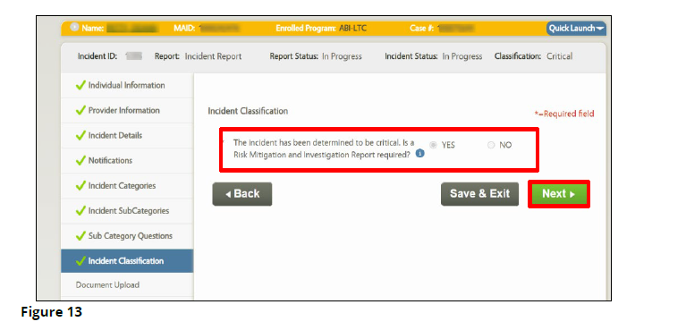
Is a Risk Mitigation and Investigation Report required? Give careful consideration to this question!
Notes:
This is a very important question in the MWMA incident screens.
If this question is answered with a no – The critical incident will then be downgraded to a non-critical incident and the RMIR screens will not populate.

Slide 19
Recategorize an Incident
Agencies can recategorize an incident if the Risk Mitigation and Investigation Report (RMIR) has NOT been submitted
Agencies can contact the help desk to have the incident recategorized: MedicaidPartnerPortal.info@ky.gov or (1-844-784-5614)
Only the Department for Aging and Independent Living (DAIL) can recategorize an incident if the Risk Mitigation and Investigation Report (RMIR) has been submitted
In these instances, email HCBinquiries@ky.gov
Notes:
This slide shows when an agency can recategorize an incident and when DAIL would need to.

Slide 20
A Few Examples – Risk Mitigation and Investigation Report
Risk Mitigation and Investigation Report (RMIR) Required
Death
Hospitalization
Emergency Medical Services involved
Elopement
Report of abuse, neglect or exploitation
Risk Mitigation and Investigation Report (RMIR) Not Required
First aid administered – no injury
Fall with assist from caregiver to the floor safely with no injury or complaint of pain
Verbal aggression – no specific target or prompting
Notes:
These are examples, but not all inclusive.
Each incident should be assessed on its own merit with the individual participant’s history taken into consideration when making the determination that a Risk Mitigation and Investigation Report (RMIR) should be completed.
While completing the Risk Mitigation and Investigation Report (RMIR) requires additional work and information gathering, the outcome is beneficial to the participant and may prevent future incidents.
It is worth the investment of time to mitigate risk and promote the health, safety, and welfare of the participant.

Slide 21
Risk Mitigation and Investigation Report (RMIR) Instructions
The Risk Mitigation and Investigation Report (RMIR) is used to provide additional information learned about the incident, describe actions taken to resolve the incident, and any additional action steps beyond those identified in the incident report to minimize reoccurrence. When considering whether a Risk Mitigation and Investigation Report (RMIR) is needed, consider the following:
Was the incident out of the responsible party’s control?
Was the incident preventable?
Could anything have been done differently to resolve the incident?
Can something be done to prevent similar incidents from happening?
Is the investigation into the incident or steps taken to resolve it on-going?
Notes:
It is important to note that when this determination is being made it is during the early stages of the incident report.
Often, there are more questions to ask and more information to learn.
A report alone may not help make the determination, so when an agency must ask more questions and investigate the situation, then #5 would apply and the Risk Mitigation and Investigation Report (RMIR) would be completed.
When in doubt, best practice would be to complete the Risk Mitigation and Investigation Report (RMIR). A participant’s health, safety, and welfare would not be negatively impacted by a Risk Mitigation and Investigation Report (RMIR) being completed.

Slide 22
Be Timely AND Investigate
Ensure Safety
File the incident report in a timely manner
Allow time to gather information for the Risk Mitigation and Investigation Report
Talk to the participant, witnesses, family members and authorized representative
Mitigate the risk
Determine the root cause
Prevent future incidents
Notes:
Be timely and investigate.
It is everyone's goal to ensure the safety of the participant.
These eight steps will help to prevent future incidents and help to ensure the participants safety.

Slide 23
Investigate – What Does That Look Like?
Speaking to all parties involved in the incident (Direct service provider, Case Manager, participant, family members, neighbors, etc.) to gather information.
01
Identifying resources that might be beneficial in helping with the incident. A few examples are food banks, elder abuse attorneys, medical supplies, equipment and appliances (MSEA) providers.
02
Review the participant’s history. This could include past incidents, case management notes or Adult Day Health Care (ADHC) notes to see if there are any trends or recent events related to the incident.
03
Notes:
Investigation what does it look like?
It means speaking to all parties, providing resources to the participant that are beneficial with the incident and reviewing their history to help prevent future incidents.

Slide 24

Participant Rights
To report incidents
To participate in interventions
To be involved in the incident investigation process
Have an advocate present when interviewed for fact finding activities.
If a waiver participant chooses not to report an incident, or declines further intervention, the incident must still be reported. The case manager or direct service provider should communicate this information to the participant.
Notes:
Let's talk about the participants rights (then read the rights).

Slide 25
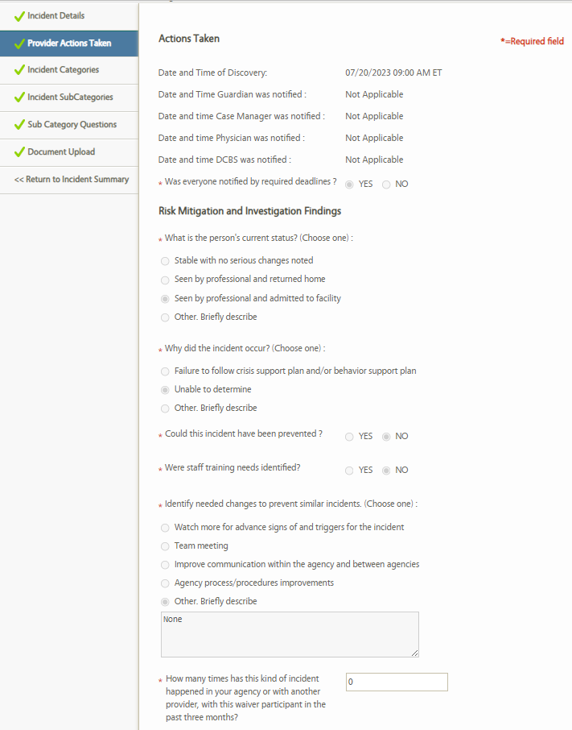
Risk Mitigation and Investigation Report (RMIR): Provider Actions Taken
Click here when finished reviewing
Staff Training Needs
In the last 3 months?
Notes:
After the incident is completed, you will have 7 days to complete the Risk Mitigation and Investigation Report (RMIR) . The Risk Mitigation and Investigation Report (RMIR) helps to identify any trends with the participant as well as any training needs from the provider. Please be sure to review the participants history, has the participant has three or more similar incidents in the last three months? If so, what mitigations efforts have you implemented to prevent future occurrences? We will talk about a few examples later in this presentations, in particularly falls.

Slide 26
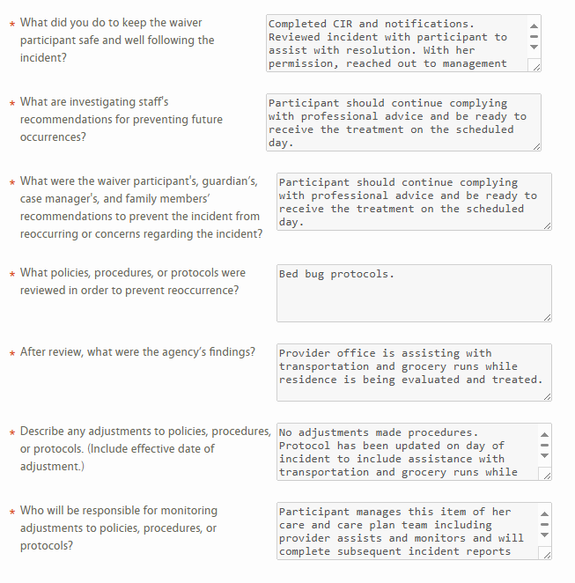
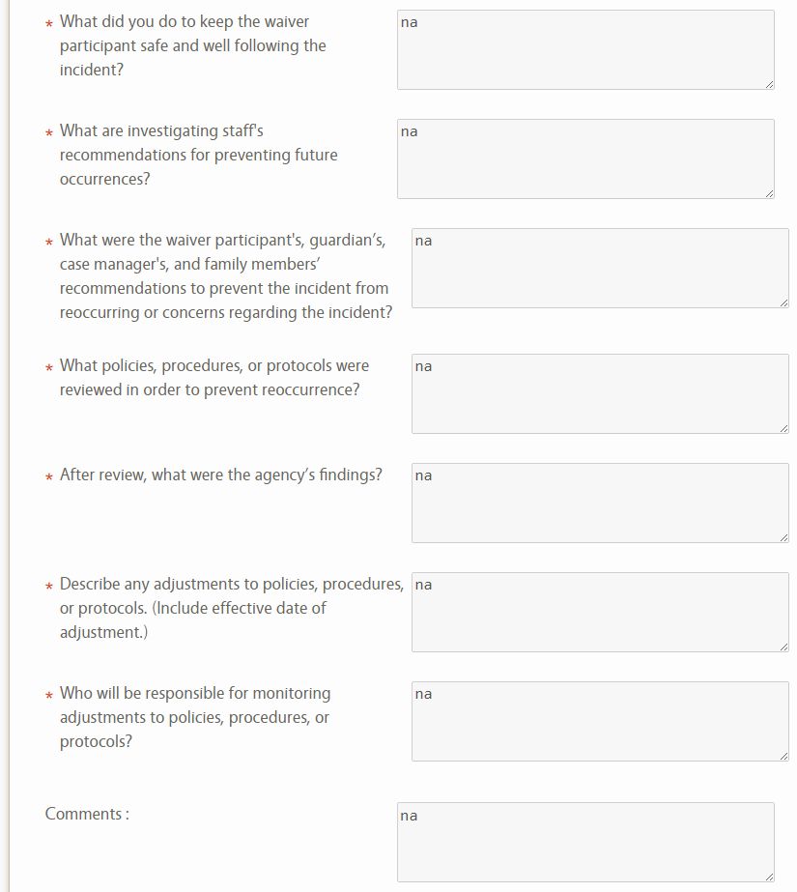
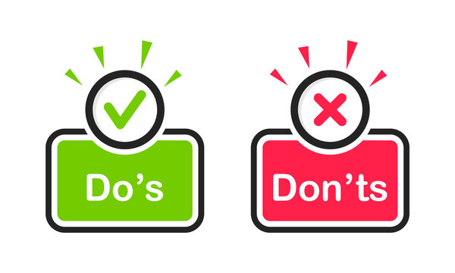
Notes:
Here are two examples of the action page of the RMIR. The one on the left gives detail while the one on the right provides no information and would require DAIL to send an RFI.

Slide 27
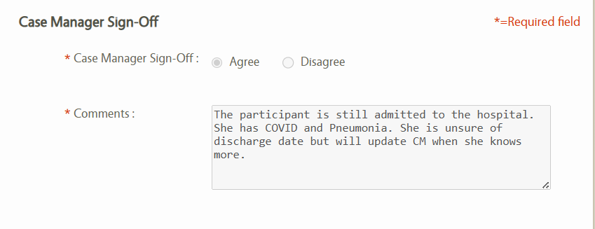
Case Manager Sign-Off SIGN-OFFCM SIGN-OFFM SIGN-OFFCMSIGN-OFF
Completed when the Incident report is initiated by a Direct Service Provider/Supervisor
Completed within 7 days
Should include a narrative, more than “Agree” or N/A.
Notes:
Case managers should clearly communicate in the comments section the actions they have taken and the information they have learned regarding the incident. This is not a field for a literal interpretation of the term “sign-off” therefore the content of this field should be more than the case managers given name, “agree” or not applicable.

Slide 28
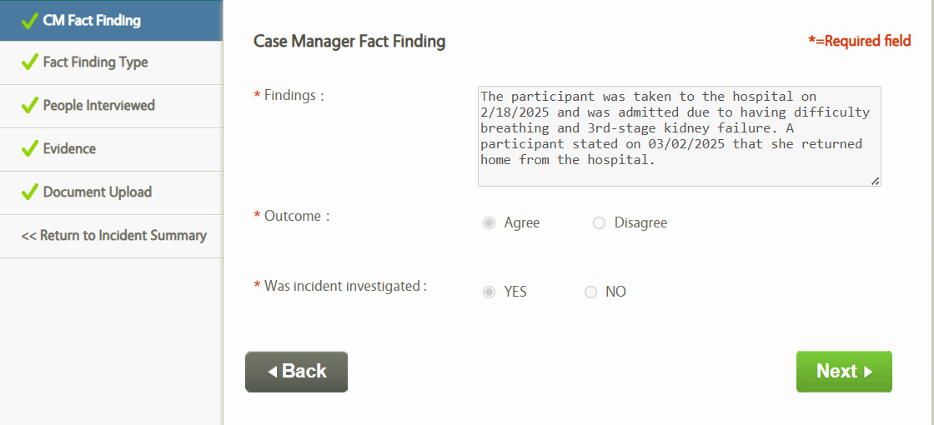
Case Manager Fact Finding Screens
If the case manager, disagrees with the findings of the Risk Mitigation and Investigation Report, the Case Manager Fact Finding Report should be completed.
The Case Manager Fact Finding should be completed within seven calendar days
Notes:
Here is an example of a completed case management fact finding screen. This should be completed if the case manager disagrees with the findings of the Risk Mitigation and Investigation Report (RMIR). Again, the case manager should utilize this opportunity to document their findings. The case manager has seven Calander days to complete this task.

Slide 29
7 Ways to Prevent a Request for Information (RFI)
Take ownership if a report is late, document an explanation and actions to prevent it from occurring in the future.
Investigate to find out when participant was discharged and when services resumed and document that information.
If an Adult Protective Services/Child Protective Services report is made, make note of the Intake ID or Web ID number that is provided and if it was accepted for investigation in the NOTIFICATION screens.
Provide update on Adult Protective Services/Child Protective Services or Law Enforcement investigations.
Submit closures in a timely manner.
Upload obituary or death certificate, when applicable.
Note tracking of 60-day rule to assess for closure and complete the Inability to Access Services Screen.
Notes:
Request for information can be prevented.
If the incident or Risk Mitigation and Investigation Report (RMIR) are late, take ownership of it. Provide an explanation as to why it was late and what actions you will take to prevent this in the future.
If the participant had been in the hospital investigate to find out when they were discharge. We also want to know when services resumed. This would apply not only if they had been in the hospital but for any reason that there was a gap in services.
Was the Department for Community Based Services (DCBS), Adult Protective Services (APS) or Child Protective Services (CPS) contacted? If so, make sure you have noted the Intake ID or Web ID on the notification screen along with date and time of referral.
If Adult Protective Services or Child Protective Services was contacted, provide an update on the investigation.
If the participant has passed away or they will not be returning home from long term care, ensure program closure is submitted timely.
If the participant has passed away include an upload of the obituary or death certificate.
If the participants services have been on hold has it exceeded 60 days or is it close? Document your acknowledgement of the 60-day rule to access services for program closure.
If you are a case manager, ensure that you are completing the inability to access services screen if the participants services have been put on hold for any reason or amount of time.

Slide 30

For clarity purposes, avoid using abbreviations.
Document additional risk mitigation efforts in progress notes/case notes.
Avoid completing the Incident Report (IR) and the Risk Mitigation and Investigation Report (RMIR) on the same (notification) day.
Keep an eye on your dashboard! It is important to manage incidents in a timely manner and to respond to requests for information timely. If you see any old incidents that remain in progress, please work to get those closed as soon as possible.
Notes:
Abbreviations can cause confusion and misunderstandings when reviewing incident documentation.
It is important for Adult Day Health Care (ADHC) staff and case managers to document additional risk mitigation efforts in progress notes/case notes.
While being timely is important, there is value in allowing time (up to 7 days) to investigate the report and gather more information. This leads to a more detailed and comprehensive Risk Mitigation and Investigation Report (RMIR).
The Department for Medicaid Services and the Department for Aging and Independent Living have identified old incidents that are significantly past due. We ask all agencies to review outstanding incidents that are still in progress and get those closed out as soon as possible. Failure to do so, could result in a formal technical assistance plan or corrective action plan. It is important for agencies and agency supervisors to keep an eye on critical incidents and provide follow up requested information in a timely manner. This routine maintenance should be completed by agencies monthly.

Slide 31

Critical Incidents & Performance Measures
Each waiver year data is collected based on each box that is checked in Medicaid Waiver Management Application (MWMA) .
The Selections YOU make matter.–Accuracy is important
Performance Measures are tied to Outcomes – Outcomes are tied to Services – Services are tied to Funding –
It all goes hand in hand!
Notes:
In this slide you will see how Critical Incidents and Performance Measures matters. You will see how it all goes hand and hand.

Slide 32

Medicaid Waiver Management Application (MWMA) extracts data that focuses specifically on Health, Safety, and Welfare.
Notes:
Health, safety, and welfare of the waiver participant is the highest priority. Under section 1915 (c) of the Social Security Act, States are required to annually report information on the health and welfare of participants.
For this reason, Medicaid Waiver Management Application extracts data from the critical incident screens to meet this federal requirement. It is important that incident information is accurate and as thorough as possible.
We continually strive to improve the incident reporting process. Agencies should invest time in reviewing case notes and incidents to avoid under reporting and ensure risk mitigation efforts are documented. Please remember to always utilize the Incident Reporting Instructional Guide for 1915(c) HCBS Waiver Services Updated: June 4, 2021, as a point of reference.

Slide 33
Health, Safety, and Welfare
A participant’s health, safety, and welfare is paramount. This is why reporting Abuse, Neglect, and Exploitation is so important. Participants also deserve to receive services free of Fraud, Waste, and Abuse.
Notes:
Medicaid Waiver Management Application extracts data that focuses on reports categorizes as abuse, neglect or exploitation.
First -If the report is categorized as abuse, neglect and exploitation, then the notification screen should reflect a report made to the appropriate authorities, the Department for Community Based Services.
Second – Please keep in mind that not all referrals are accepted. If you call the Kentucky Hotline you can give more detailed information than you can through the web.
Reporting Fraud, Waste, and Abuse is equally as important to document as it also directly impacts the participant’s health, safety, and welfare. Participants have a right to receive waiver services, free from fraud, waste, or program abuse. Remember to report these concerns to the Office of Inspector General or the Attorney General’s office and remember to appropriately completed the notification screen.

Slide 34
Be mindful of the definitions
Before checking the box, make sure it is applicable to the situation at hand.
Restraints and Seclusions are prohibited and should be reported and investigated immediately
Notes:
During the DAIL review process, it has been identified that agencies have classified an incident as including restraints or seclusions, when that has not actually been the case. Everyone knows or should know that restraints and seclusions are prohibited in serving waiver participants.
While a participant may decide to seclude themselves, this would not be classified on an incident as seclusion. A seclusion is an involuntary confinement. This would be an act against the participant. Please see the next slide as a reminder of the terminology being utilized. An incorrect categorization could imply an agency is in violation of the waiver application/regulations when that was not actually the case.

Slide 35

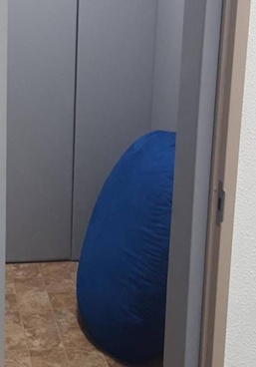
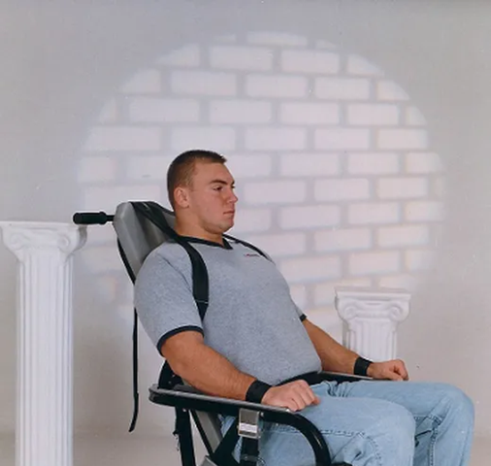
Restraints and Seclusions
"Chemical restraint" means a drug or medication.
"Physical restraint" means any manual method or physical or mechanical device, material, or equipment.
"Seclusion" means the involuntary confinement of a participant.
Notes:
Please ensure staff are aware of these definitions. Accuracy in categorizing and incident is important and as mentioned previously, these are directly tied to wavier assurances.
"Chemical restraint" means a drug or medication:
(a) Used to restrict an individual's:
1. Behavior; or
2. Freedom of movement; and
(b)
1. That is not a standard treatment for the individual's condition; or
2. Dosage that is not an appropriate dosage for the individual's condition.
"Physical restraint" means any manual method or physical or mechanical device, material, or equipment that:
(a) Immobilizes or reduces the ability of a person to move his or her arms, legs, body, or head freely; and
(b) Does not include orthopedically prescribed devices or other devices, surgical dressings or bandages, protective helmets, or other methods that involve the physical holding of a person for the purpose of:
1. Conducting routine physical examinations or tests;
2. Protecting the person from falling out of bed; or
3. Permitting the person to participate in activities without the risk of physical harm.
"Seclusion" means the involuntary confinement of a participant alone in:
(a) A room; or
(b) An area from which the participant is physically prevented from leaving.

Slide 36
Root Cause
DEFINE
The problem
COLLECT
Data
IDENTIFY
Possible causal factors
ANALYZE
Root cause(s)
RECOMMEND AND IMPLEMENT
Solutions
Notes:
MWMA also extracts data to determine if there were a root cause identified.
This is part of the action page on the Risk Mitigation and Investigation Report (RMIR).
When you are completing the Risk Mitigation and Investigation Report (RMIR) think about these five things during your investigation:
Define the problem.
Collect data to gather information.
Were there any factors that contributed to the incident?
Analyze all the information you gathered.
Finally, recommend and implement solutions.
These steps will help you determine why the incident occurred, which is directly asked on the Risk Mitigation and Investigation Report (RMIR).

Slide 37

Devote the Time…Ask the Questions
Are you identifying trends? Dehydration, Urinary Tract Infections, Falls, Trips to the Emergency Room?
Are you determining the root cause? Is there time on the agenda in a monthly meeting to discuss? Do you hold quarterly meetings just on this topic?
Are you actively taking steps to intervene, do something different, offer suggestions, additional education or supports?
What additional supports do you need from the Department for Aging and Independent Living?
Notes:
Incidents can be a reflection of the services being provided. When you are reviewing an incident think about the following questions (then read the questions from the slide).
Are you identifying trends such as Dehydration, Urinary Tract Infections, Falls or Trips to the Emergency Room?
Are you determining the root cause for the incident?
Does your agency meet monthly or quarterly to go over this topic?
Are you taking steps to intervene to help prevent future incidents and providing additional education and supports?
What can DAIL do to assist you? For example, DAIL collaborated with Behavioral Health to offer a suicide training due to the amount of critical incidents related to suicidal ideations.

Slide 38
Is the participant in a safe environment?
Is there a need for a team meeting?
Was the incident preventable?
Was abuse, neglect or exploitation discovered and reported?
Is the participant still in the hospital? Have the inability to access services screens been completed in Medicaid Waiver Management Application (MWMA)?
If the participant passed away, is the death certificate or obituary uploaded in documents?
Are there unmet needs? Are actions being taken?
Was fraud discovered and reported?
Have services resumed?
Critical Thinking
Notes:
When completing the incident try and make sure there no are no questions left to be asked. The incident should tell a story of what happened.
Is the participant in a safe environment?
Is there a need for a team meeting based on the information gathered?
Was the incident preventable?
Are there any unmet needs and what actions are being taken to resolve the need?
Was abuse, neglect or exploitation discovered? If so, was it reported?
Was fraud discovered, if so, was it reported?
Is the participant still in the hospital? Have the inability to access services screens been completed?
Have services resumed, if so, what date? If not, is there a reason why?
If the participant passed away, is the death certificate or obituary uploaded in documents?

Slide 39

Is your agency making a concerted effort to tackle an issue or trend?
Dehydration, Urinary Tract Infection (UTI), Altered mental status
Is the participant not drinking because…
Do not want to have to go to the bathroom?
Do not want to inconvenience a caregiver?
Do not want to sit in a wet brief?
Do not want to be fussed at for being incontinent?
Causing more laundry which leads to an increased water bill?
Give it some thought and have a conversation directly with the participant about it.
Notes:
Next, we are going to look at interventions and ways to mitigate risk to prevent future occurrences.
We see many incidents related to dehydration and urinary tract infections (UTI’s). Both can cause an altered mental status.
When a participant has multiple incidents for urinary tract infection or dehydration have you considered the following are they not drinking because they don’t want to go to the bathroom or inconvenience a caregiver? Would they have to sit in a wet brief? Are they afraid they would be fussed at for being incontinent? Would they be concerned about the increase in laundry due to being incontinent.
It's important to speak with the participant when incidents occur and see if there is a reason behind the incident you may not directly see.

Slide 40

Falls
Is the participant strong willed and holding on to independence even though they do not have the strength to stand or ambulate on their own?
Does the participant refuse to use a cane or a walker – Do you know why? Have you asked?
Is the house full of clutter? Could the participant exit the home in the event of an emergency or fire?
Does the participant fully understand the risk? Subsequent falls could lead to a broken bone, which might require hospitalization/nursing home placement and ultimately derail their desire to stay in their own home and community?
What is the participant willing to do to be able to stay in the home?
How can we educate the participant and support their choices?
Notes:
A large portion of incidents are related to falls and sometimes there are mitigation efforts that could help prevent the participant from falling in the future.
Consider these questions the next time you complete an incident for a fall:
Is the participant not willing to give up their independence even though they don’t have the strength to stand or ambulate on their own?
Are the walkways free of clutter?
Does the participant refuse to use a cane or a walker , if so, do you know why? If they do not have one, would an ambulation device be beneficial?
Have you discussed with them the risk of continuous falls?
Speak to the participant, what are they willing to do to maintain their independence in their home. How can you educate and support their choices?

Slide 41
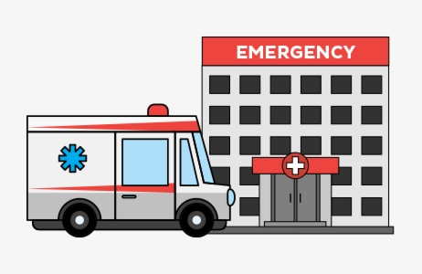
Emergency Room Visits
Has there been a change in medication? Is there a new diagnosis?
Is there a pattern of emergency room visits?
Is the participant sent home without treatment
Has the participant had multiple hospitalizations?
Has there been a consultation with the primary care physician?
What supports or interventions would help in these situations?
Notes:
Incidents are often related to emergency room visits. When submitting an incident for a visit to the emergency room or urgent care please ensure that you provide detailed information of what happened before, during and after the incident.
Document any medication changes or new diagnosis
Review the last three months, is there a pattern of visits to the emergency room or urgent care?
Has the participant had multiple hospitalizations and are they related to the incident?
Was the participant released without treatment? If so, where they referred to see someone else?
Does the participant have a primary care physician they see on a regular basis and was a follow up needed from the emergency room or urgent care?
Think about the supports or interventions that could help if the participant frequently goes to the emergency room or if they were not able to be treated.

Slide 42
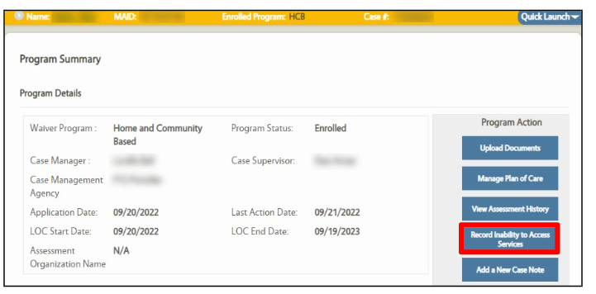
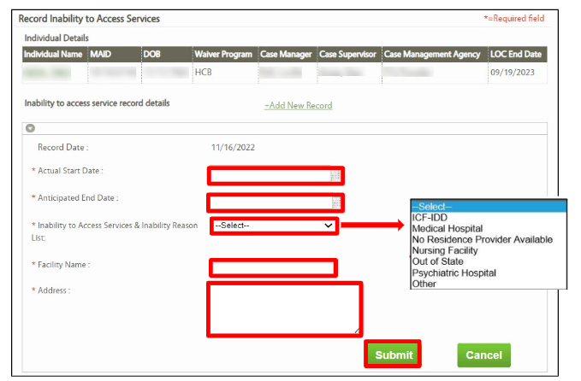
Inability to Access Services
Inpatient Hospitalization, Nursing Facility, or Out of State
Notes:
When an Individual is unable to access services (ex. Admitted to a Nursing Facility or Inpatient Hospitalization), an Inability to Access Services Record must be entered in MWMA.
It is necessary to update the Inability to Access Services Record when the Individual returns to services, or if it has been determined the Individual will not be returning to services.
For assistance requesting an Inability to Access Services extension for a 1915(c) Home and Community Based Services waiver program, please call the Cabinet for Health and Family Services (CHFS) Department for Medicaid Services (DMS) 1915(c) HCBS Waiver Help Desk at 844-784-5614, or email 1915cwaiverhelpdesk@ky.gov
.

Slide 43

Support System
Is it positive or negative?
Do they tolerate unacceptable behaviors because they feel they have no choice?
Notes:
When completing incidents, think about the participants support system, is positive or negative? Are there supports not currently offered that could benefit the participant such as home delivered meals. If the participants supports are negative, is it because they feel like they do not have a choice? It is important for the participants to be offered supports and know they have the freedom to choose.

Slide 44
Benefits of Preventative Efforts
PARTICIPANT
Healthier
Safer
Improved quality of life
Able to stay in the community longer
More prepared on what action to take to prevent similar incidents
More educated on the critical incident process, especially abuse, neglect and exploitation
AGENCY
More time to serve participants
Better outcomes for everyone
Able to serve participants longer in the community
Less costly interventions – ex. trips to emergency room
Less time completing incidents
Notes:
There are many benefits of incident reporting for both the participant and the agency.

Slide 45
Where do we go from here?
Continuous Quality Improvement
Monitoring
Data Collection
Remediation
Measurable change
Notes:
Not only is it important to ensure incidents are reported timely and accurately but it is equally important to monitor incidents reported by provider. This helps providers to monitor incidents internally and collect data.
As the Department for Aging and Independent Living moves forward in our quality assurance efforts, it may be necessary to issue formal, written technical assistance plans to agencies who, for example, continue to demonstrate difficulty:
Completing incident reports in a timely manner
Fails to report incidents (underreporting)
Continuously downgrades critical incidents to non-critical
Fails to report abuse, neglect, and exploitation
Fails to document provider actions taken on the Risk Mitigation and Investigation Reports
Fails to respond to requests for information
Fails to complete the inability to access services screens
If technical assistance efforts are not successful and an agency exhibits a repeated pattern of behavior with regard to incident compliance, then a Corrective Action Plan (CAP) will be considered.

Slide 46
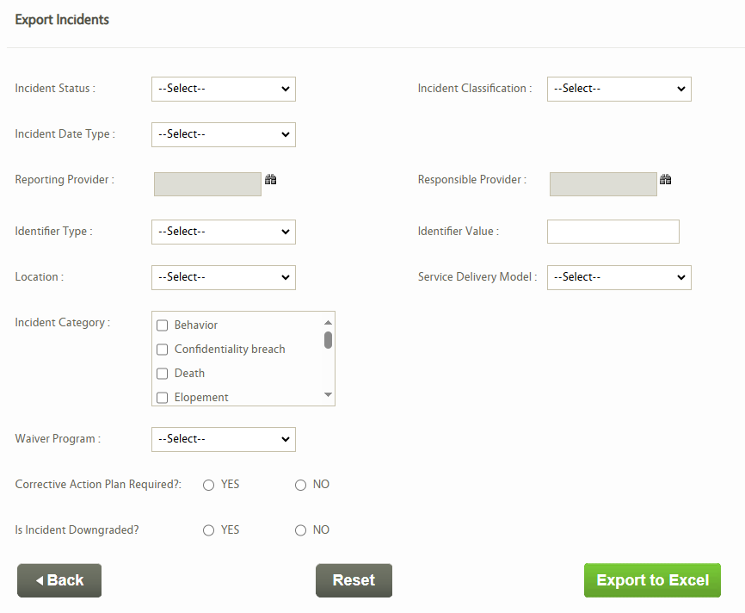
Reports in Medicaid Waiver Management Application (MWMA)
Export Incidents
Monthly
Quarterly
Annually
Providers can select based on the category and/or subcategory. A specific waiver program can also be selected.
Analyze the Data
Trends
Root Cause
Educational Needs
Opportunities for growth
Notes:
The Department for Aging and Independent Living utilizes the reports generated through Medicaid Waiver Management Application (MWMA) to review incidents. Providers can as well . This can help providers identify trends and areas that may need improvement.

Slide 47
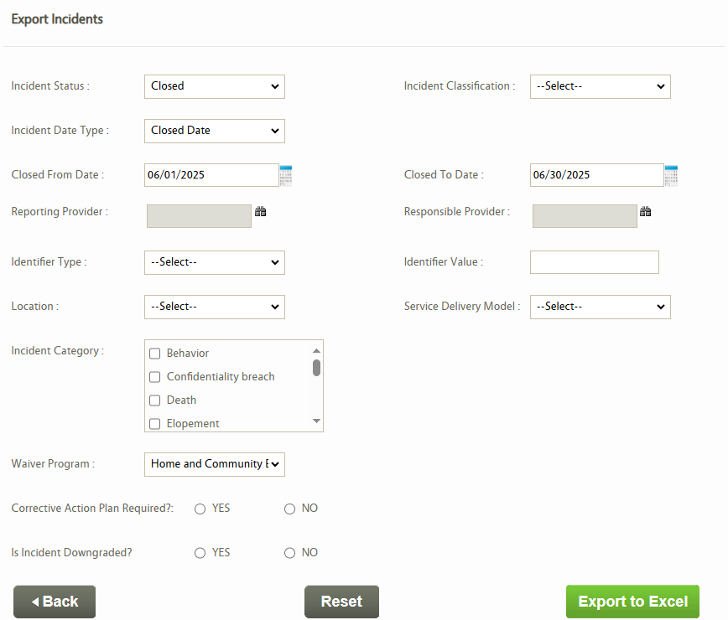

This example is not filtered by provider. You can add the reporting provider before exporting the report or you can filter the report after it generates.
If the Direct Service Provider submitted the incident and the Case Management agency was not the reporting provider, the incident will not generate on the Case Management Agency report if you add the reporting provider.
Notes:
Once the report is generated you can filter the report based on the information you are trying to gather. One area providers can look at on the report is incidents categorized as abuse, neglect or exploitation. They can then identify how many incidents were reported by their agency and how many were not reported to the appropriate authorities.

Slide 48
EVALUATION
Assessment
Analysis
Performance
Improvement
Results
Feedback
Provider Input
What do you think works well, what are our opportunities for growth?
What do you think you can do with Critical Incident information within your agency?
How can your agency implement a quality improvement process?
Provide suggestions to the Department for Aging and Independent Living for improvements, we want your feedback.
Notes:
With all the information provided today, think about your agency. What can you do with the information you have bene given to help your agency grow and improve?

Slide 49

Partner with us to improve the critical incident reporting process
The Department for Aging and Independent Living is available to provide technical assistance at any time. Please do not hesitate to reach out.
Notes:
We hope that we have provided an opportunity for learning and that you have more knowledge on reporting critical incidents. Thank you

Slide 50
RESOURCES
Home- and Community-Based Services Waiver Programs - Cabinet for Health and Family Services
Department for Aging and Independent Living - Cabinet for Health and Family Services
https://www.chfs.ky.gov/agencies/dms/dca/Documents/irinstructionalguide.pdf
https://prd.webapps.chfs.ky.gov/reportabuse/OutofHours.aspx
https://KYESTEAM.ky.gov
https://www.chfs.ky.gov/agencies/dcbs/dpp/Documents/reportingchildabuseneglecthandbook.pdf
https://www.chfs.ky.gov/agencies/dms/dpi/Pages/fraud-abuse.aspx
Adobe Learning Manager (ALM) - To access, you will need to create your own individual account. Account creation requests will no longer be submitted to Medicaid Waiver Management Application (MWMA) technical support staff. Follow the steps below to create your Adobe Learning Manager account.
To create your account, please select the following link: Medicaid Waiver Management Application (MWMA) Users. All users must use this link as a one-time self-registration option to create an account.

Slide 51

Department for Aging and Independent Living
877-315-0589
HCBInquiries@ky.gov
Notes:
If you have questions, please do not hesitate to reach out to the Department for Aging and Independent Living at 877-315-0589 or by email at HCBInquiries@ky.gov. Thank you

